Slide 1










Jorge Audy, audy@pucrs.br
Superintendent for Innovation and Development at PUCRS and Tecnopuc

Slide 2
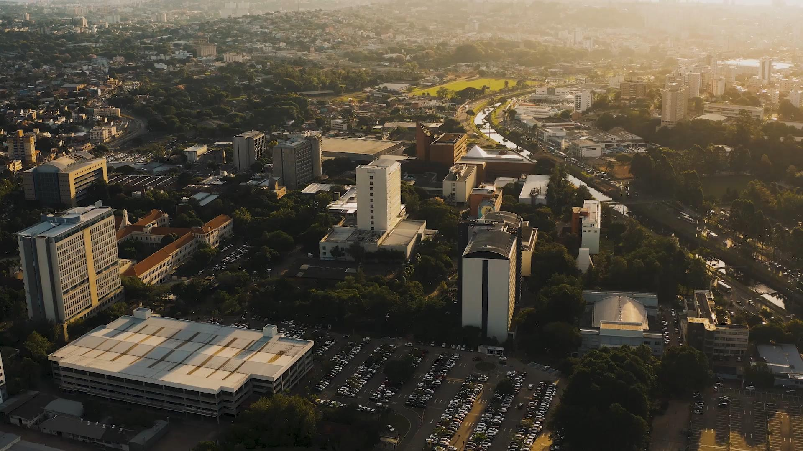




Pontifical Catholic University of Rio Grande do Sul
A university that is as great as the future.
Una Universidad que es grande como el futuro

Slide 3



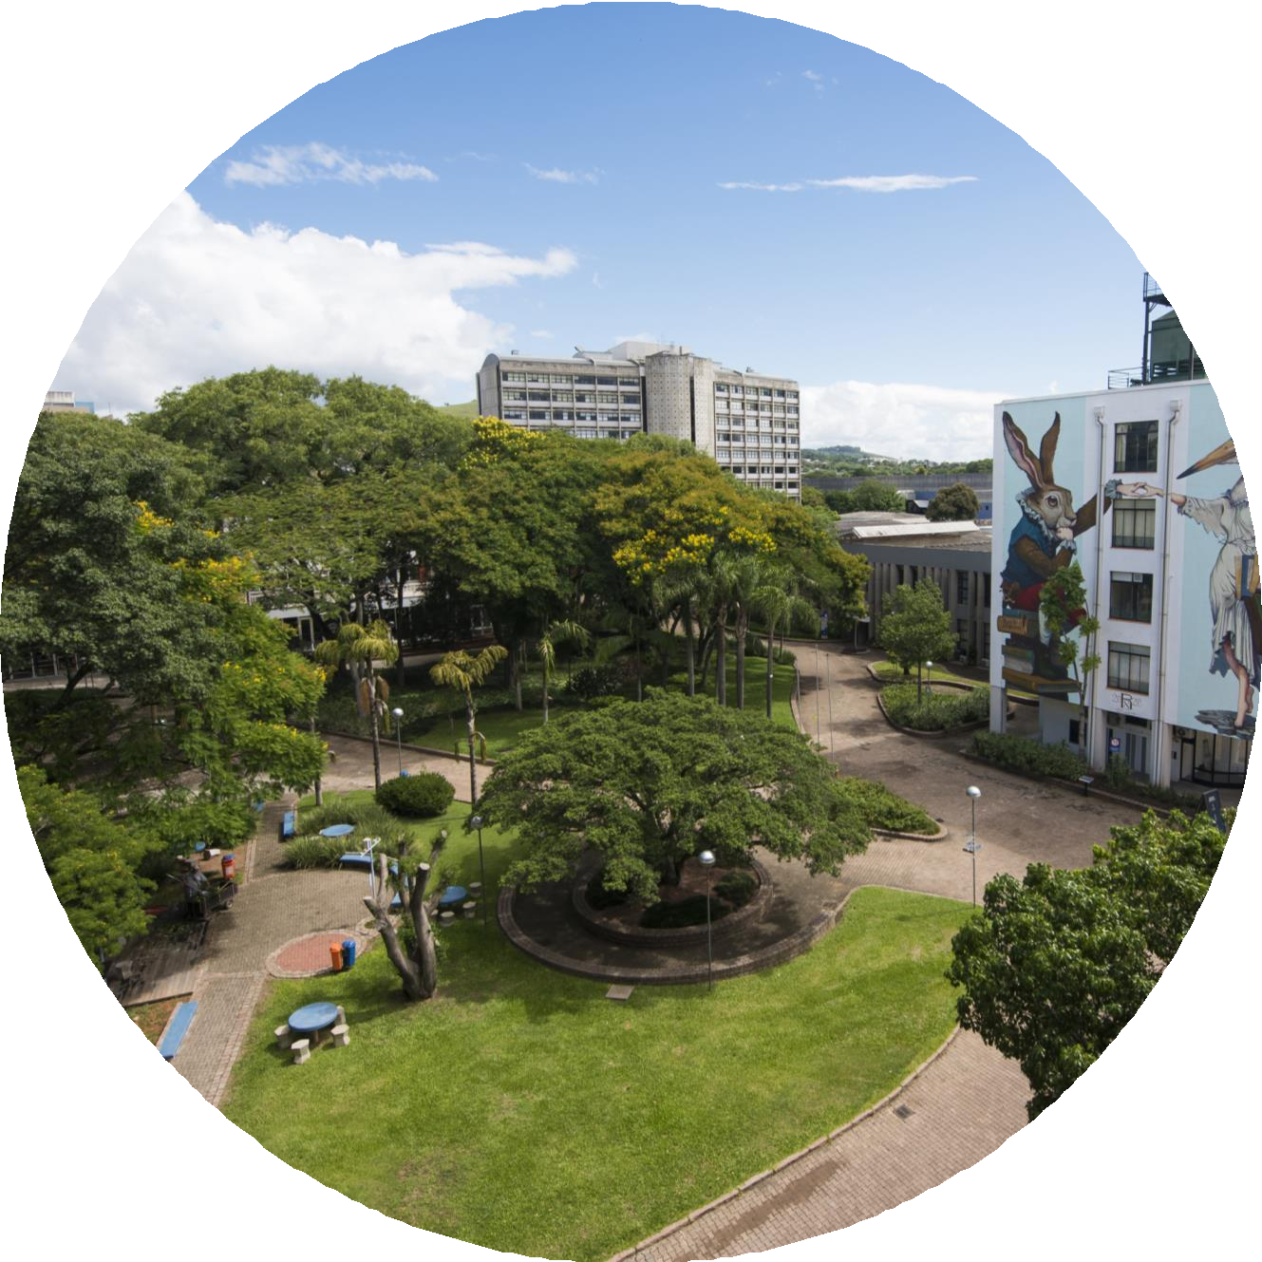





With 75 years of existence, PUCRS
is one of the
higher education institutions in Brazil. It is a private and non-profit Marist university where teaching and high impact scientific research go hand in hand. PUCRS believes in education for life and in people’s development for the exercise of citizenship, justice and fellowship.
03

Slide 4




















The Network includes 27 institutions from all over the world, from countries such as Australia, Argentina, Brazil, Spain, United States, Philippines, Kenya, Mexico, Peru and East Timor. Since 2004, it has been working to create multidirectional connections in inter- institutional communication with Marist universities.
04

Slide 5









WE ARE A UNIVERSITY THAT
We prepare more than competent
professionals for the job market: we
prepare responsible citizens who promote human, personal and social excellence, as we understand the leading role we play in the development of our country and the
world.
05

Slide 6










Context
New Technologies

Slide 7


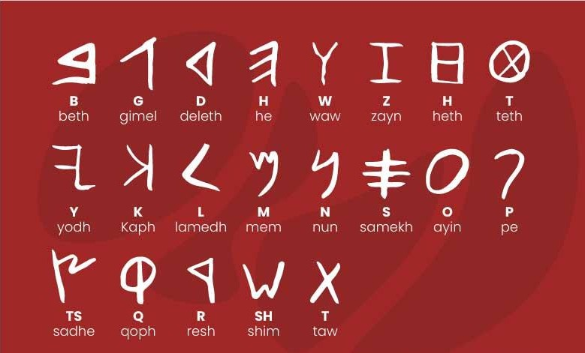
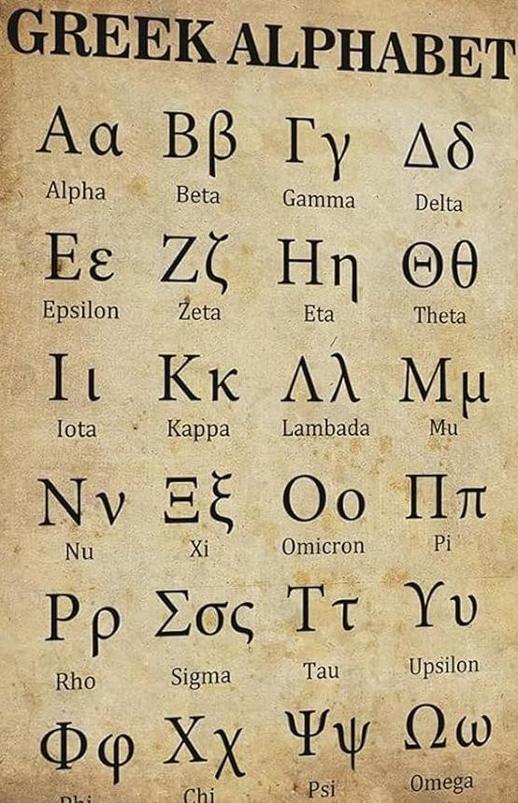
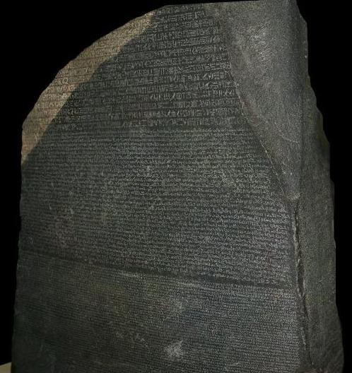


Phoenician Alphabet (Levant) 15 BC
Hieroglyphs
Greek Alphabet 8 BC Latin Alphabet 7 BC

Slide 8


1.8 million years (Paleolithic)
800 thousand years – controlled use 7,000 years BC – control of fire (Neolithic)

Slide 9

3.5 thousand years – Mesopotamia (Iraq)
2.5 thousand years – Sumerian war chariot

Slide 10


Slide 11
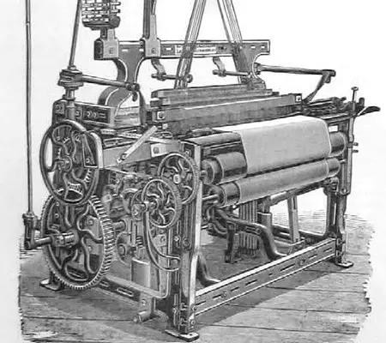
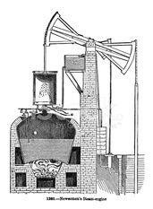
Cartwright’s Loom
Newcomen’s Steam Engine

Slide 12




'
.4
C
י
ו
י

Slide 13
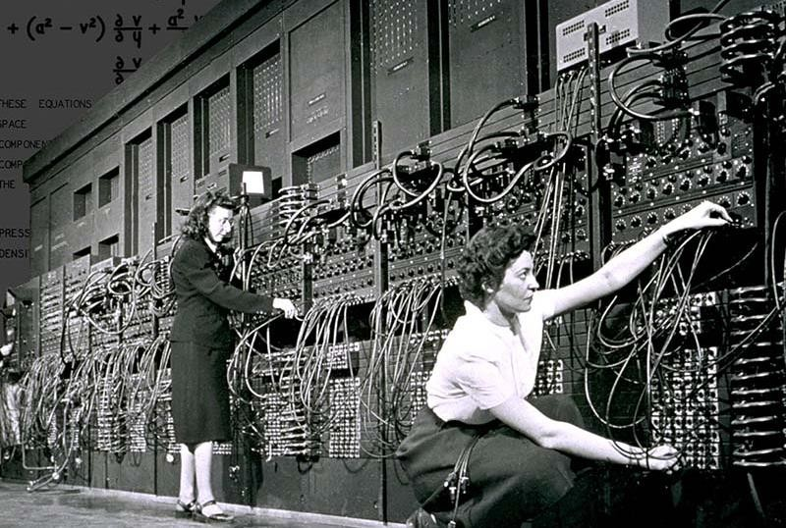
ENIAC missile trajectories UPenn

Slide 14


Slide 15


Slide 16


We are on the threshold of a new paradigm in a society driven by disruptive innovations, with a strong impact from new technologies and learning and research environments. The challenge ahead is to develop a new education for a new society, suited to the times we are living in.
It is still not very clear what the future will hold, but it certainly will not be a continuation of what is happening today.

Slide 17



Evolution of
the idea of a University

Slide 18

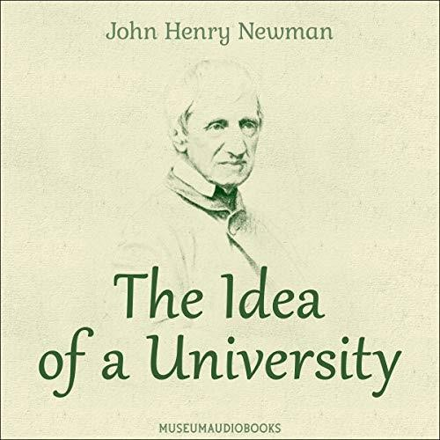



Slide 19

A vision of the University
The university is a place of excellence. It is the seat of wisdom, a light in the world, a minister of faith, the alma mater of the emerging generation.
La Universidad es el lugar de la excelencia. Es la sede de la sabiduría, una luz en el mundo, um ministro de la fe, el alma máter de la generación que surge.
Acerca de la Idea de Universidad
John Henry Newman (1801-1890)

Slide 20
A vision of the University
…and those who never aim, never hit; those who do not take risks, never win; that always staying safe is always being weak; and that doing some substantial good outweighs the imperfections that may arise from having undertaken it in the first place.
... y los que nunca apuntam, jamás aciertan; que los que no arriesgan, nunca ganan; que estar siempre a salvo es ser siempre débil, y que acer algun bien sustancial compensa las imperfecciones que surgiesen del hecho mismo de haberlo empreendido.
Acerca de la Idea de Universidad
John Henry Newman (1801-1890)

Slide 21
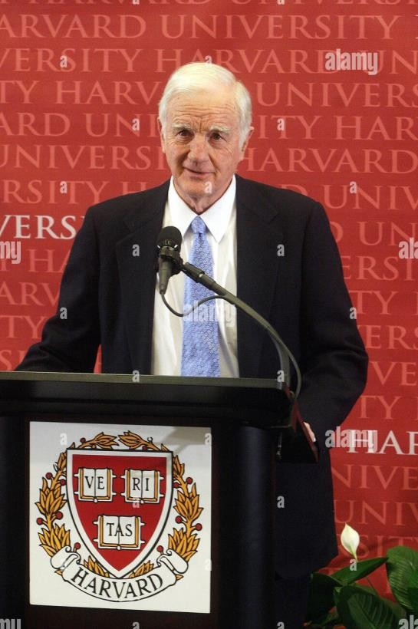
A vision of the University
After World War II, the image of the Ivory Tower became obsolete. In its place, a vast and intricate network of relations was created to connect universities with other relevant societal institutions.
Beyond the Ivory Tower
Derek Bok
President of Harvard University, between 1971 and 1991

Slide 22
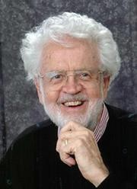
A vision of the University
Entrepreneurial University is an active institution that makes changes in its structure and in the way it acts and reacts to internal and external demands, with the capacity to adapt to the changes of an evolving society. It takes a proactive stance in transforming generated knowledge into added social, economic, and cultural value, and is inseparable from the triad of R&D&I.
Burton Clark
Researcher at UCLA, in the Higher Education field

Slide 23


A vision of the University
Faced with the numerous challenges of the future, education constitutes an indispensable instrument for humanity to progress toward the ideals of peace, freedom, and social justice.
Frente a los numerosos desafíos del provenir, la educacion constituye un instrumento indispensable para que la humanidad pueda progressar hasta los ideales de paz, libertad y justicia social.
Education or the Necessary Utopia Education Holds a Treasure
Report of the UNESCO International Commission on Education for the Twenty-first Century Jacques Delors, UNESCO, 1996
La educación o la utopia necessária La Educación Encierra un Tesoro
Informe de la Unesco de la Comission Internacional sobre la Educación para el Siglo XXI Jacques Delors, UNESCO, 1996

Slide 24
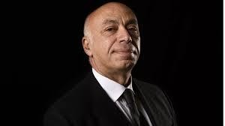
A vision of the University
As never before in history, higher education is a determining factor in the economic and social development of the society in which it is embedded.
Statement from the WCHE World Conference on Higher Education, Paris George Haddad, UNESCO, 2009

Slide 25



1st Mission: 11th century, Teaching

Slide 26
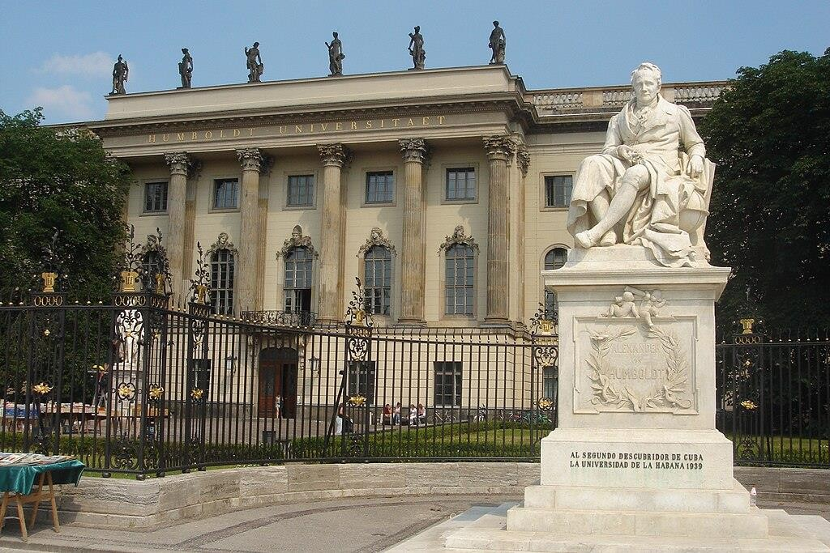
2nd Mission: 19th century, Research

Slide 27
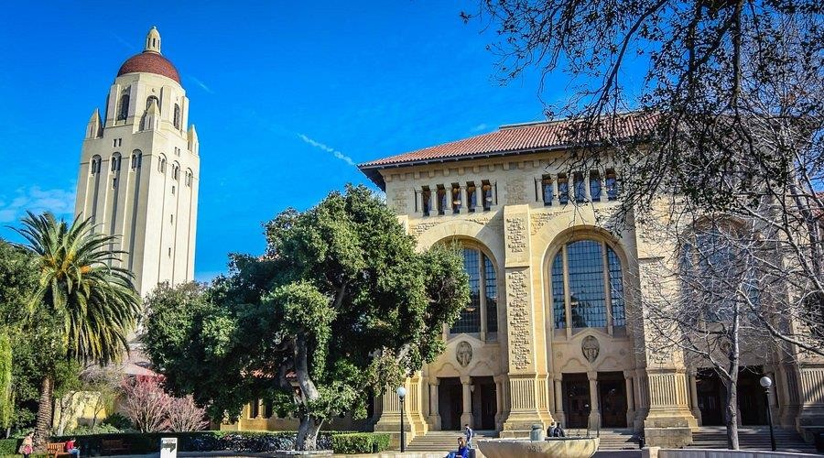
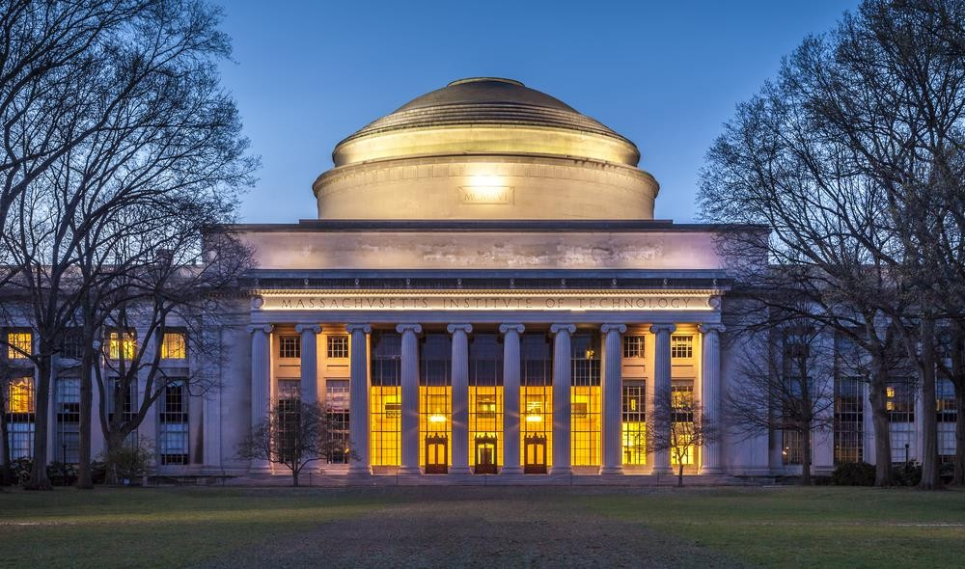
3rd Mission: 20th century, Innovation

Slide 28


- Expanding its traditional focus on education and training (teaching and research)
- Adding to its mission a direct role in the social, economic, and environmental development of society
E3M Project: Green Paper (Unesco and European Community) S3 Project: Smart Especialization (European Community)

Slide 29
Looking to the Future

Slide 30

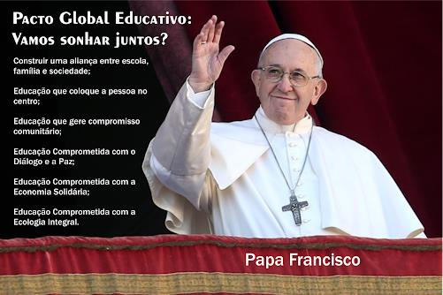

Global Education Compact:
Shall we dream together?
Building an alliance between school,
family, and society;
Education that puts the person at
the center;
Education that fosters community
engagement;
Education committed to dialogue
and peace;
Education committed to a solidarity-based economy;
Education committed to integral
ecology;
Pope Francis

Slide 31
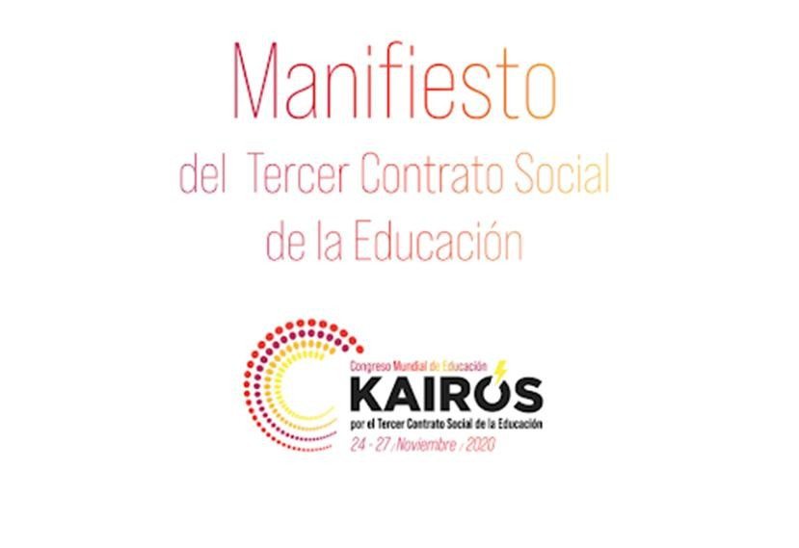


Slide 32
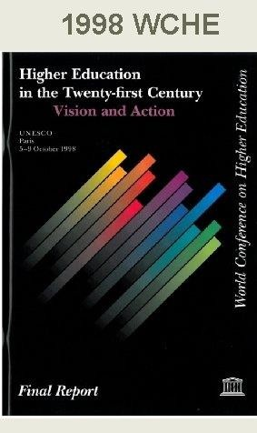
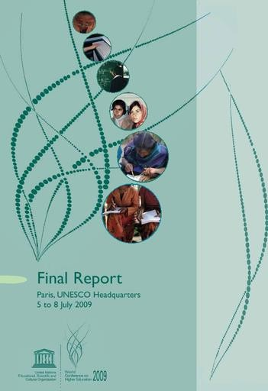

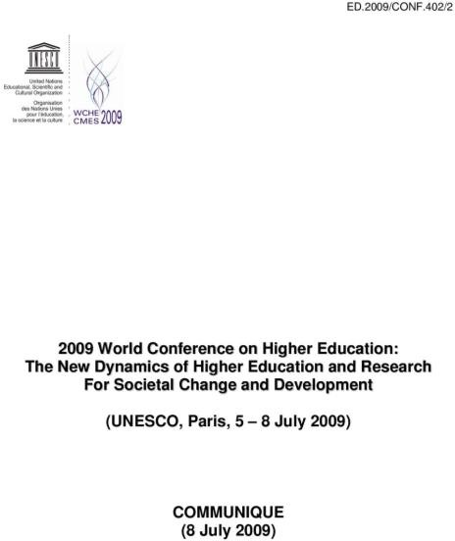
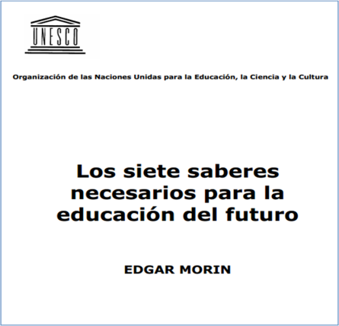
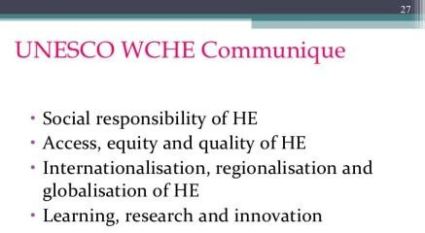

Slide 33

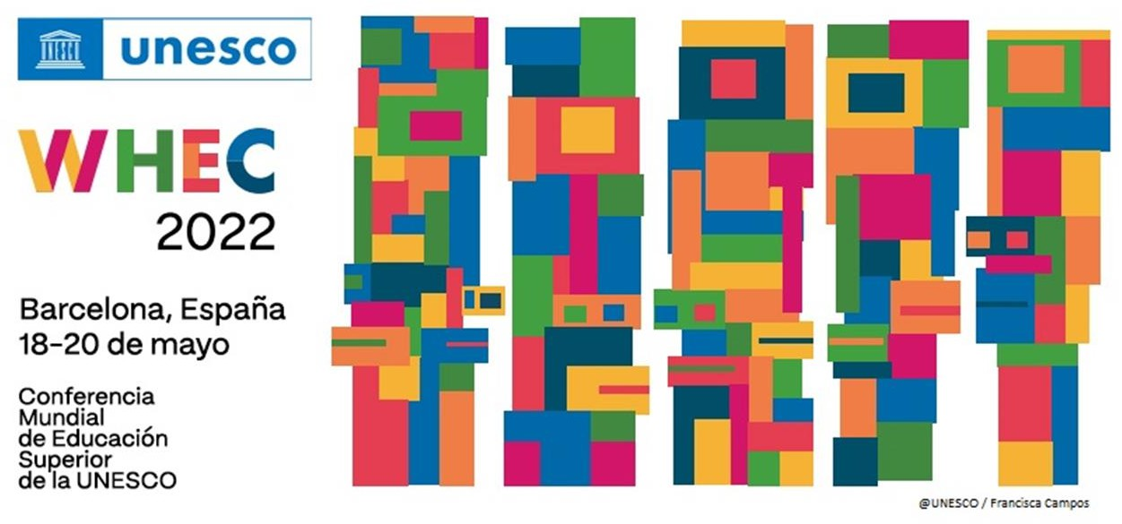


Slide 34







1st Mission – TEACHING
Education for global citizens, prepared to deal with
growing complexity
2nd Mission – RESEARCH
Shared knowledge and Open Science through transdisciplinary approaches
3rd Mission – INNOVATION & SOCIAL ENGAGEMENT
Social engagement and ethical responsibility
A driving force for social, environmental, economic, and cultural development in society

Slide 35

dangers of commodification and standardization.
Commission member Professor António Nóvoa warning against the
“One of the most damaging trends of recent decades is the idea that there is a single university model induced by uniform rankings that all should seek to emulate. Universities need to develop their own projects based on their histories, roots and missions. Global standardization does not serve the internationalization of cooperation and opportunities for the mobility of all students and teachers and the purpose of a multicentered world.”
“Universities must be ecosystems for innovation and citizenship interlinked with cities and democratic participation.”
35

Slide 36
Final Reflections

Slide 37

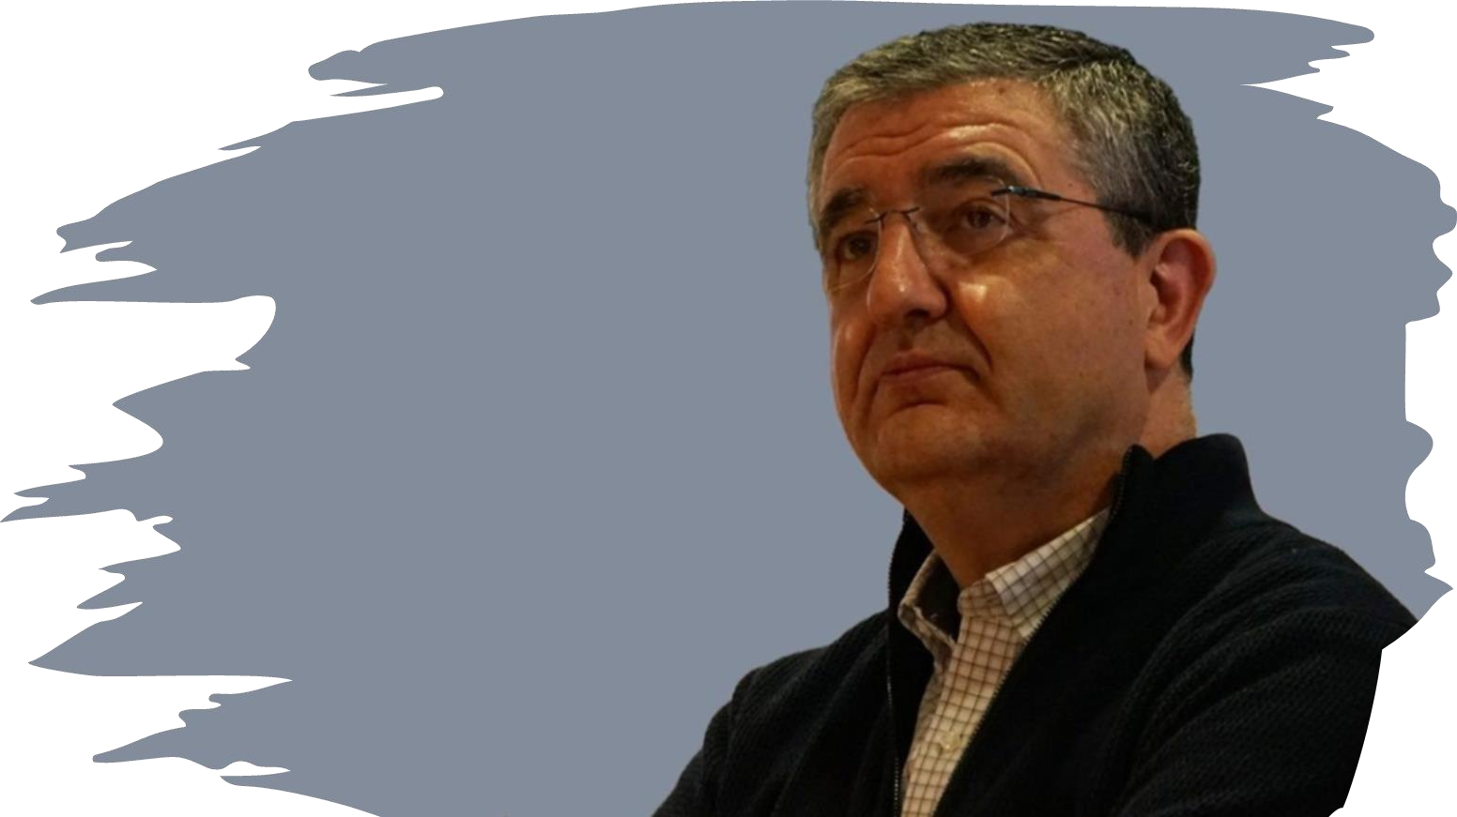
People
Purpose
(Mission, Vision for the Future, Values)
Leadership

Slide 38
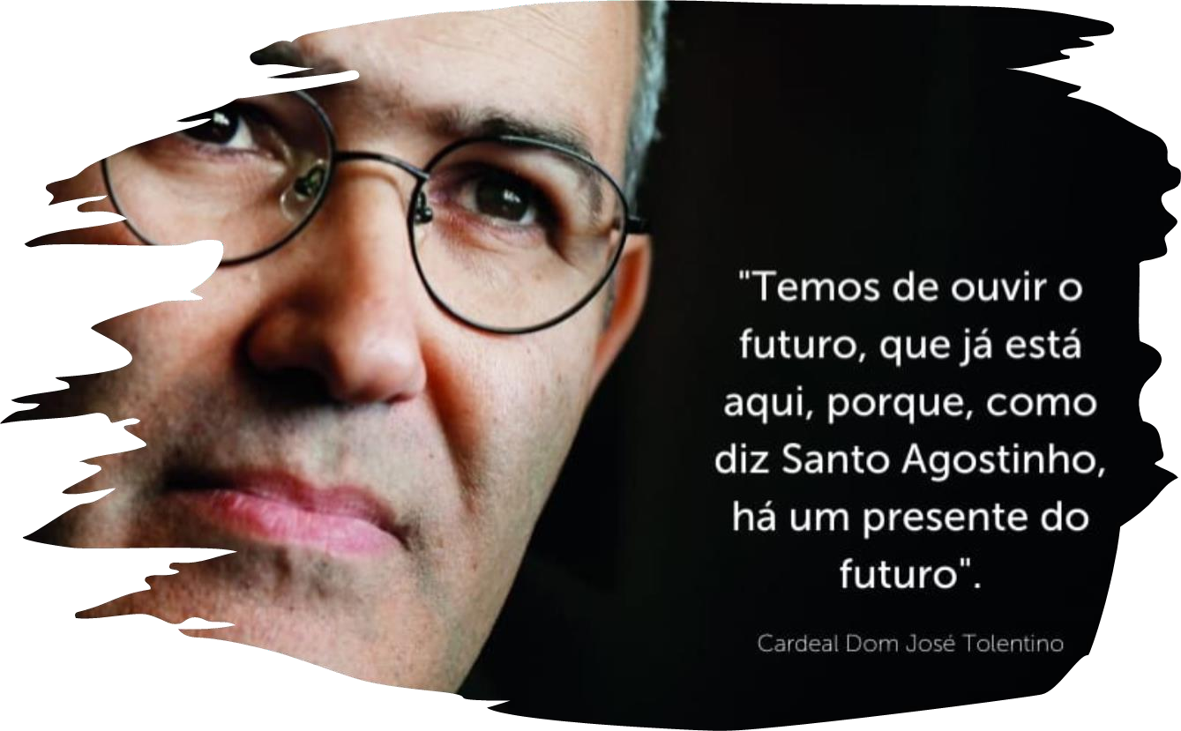
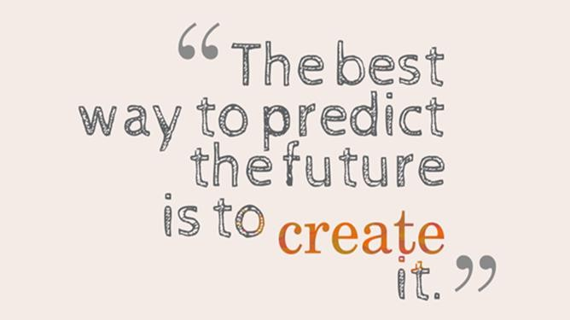
“We must listen to the future, which is already here, because as Saint Augustine says, there is a presente in the future.”
Cardinal José Tolentino

Slide 39
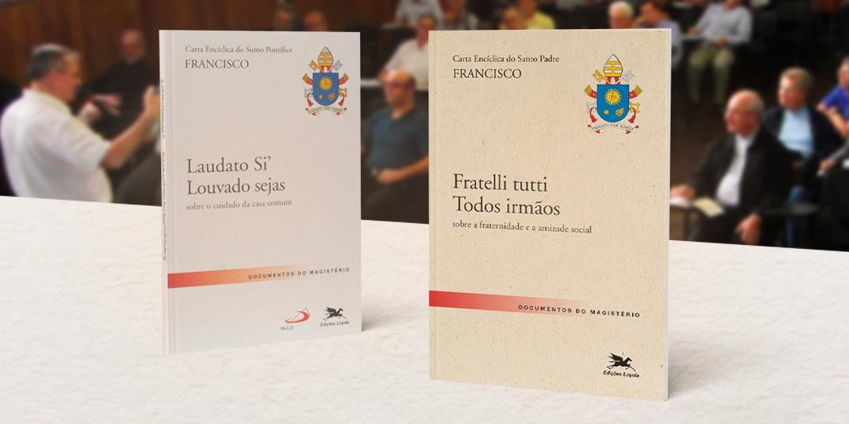
An approach grounded in global values...
Love / Compassion / Solidarity
Social & Environmental Responsibility

Slide 40


An approach grounded in global values...
Simplicity, Modesty & Humility

Slide 41
Our higher education institutions must put their tradition and quality at the service of the necessary renewal to
fulfill their mission.
This must be done consistently with their principles and values
(mission, vision, and guiding framework).
It involves pursuing a new education for a new society, in harmony with the times!

Slide 42

MARISTA

Slide 43



Slide 44







Jorge Audy, audy@pucrs.br
Superintendent for Innovation and Development at PUCRS and Tecnopuc

